Slide 1


Python for Beginners
Archer Infotech , PUNE
www.archerinfotech.in

Slide 2
Python – Logistic Regression

Slide 3


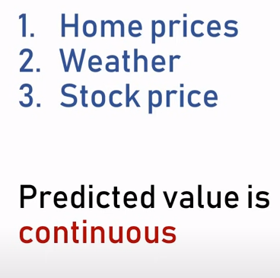
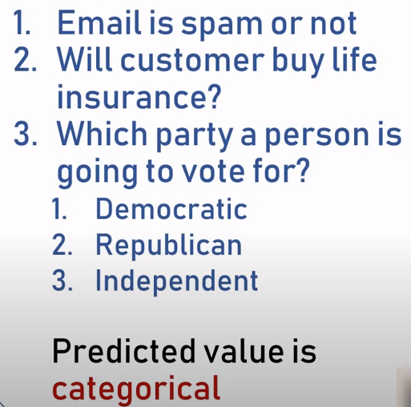
Logistic Regression

Slide 4
Logistic Regression
Logistic regression is one of the most popular Machine Learning algorithms, which comes under the Supervised Learning technique. It is used for predicting the categorical dependent variable using a given set of independent variables.
Logistic regression predicts the output of a categorical dependent variable. Therefore the outcome must be a categorical or discrete value. It can be either Yes or No, 0 or 1, true or False, etc. but instead of giving the exact value as 0 and 1, it gives the probabilistic values which lie between 0 and 1.
In Logistic regression, instead of fitting a regression line, we fit an "S" shaped logistic function, which predicts two maximum values (0 or 1).

Slide 5
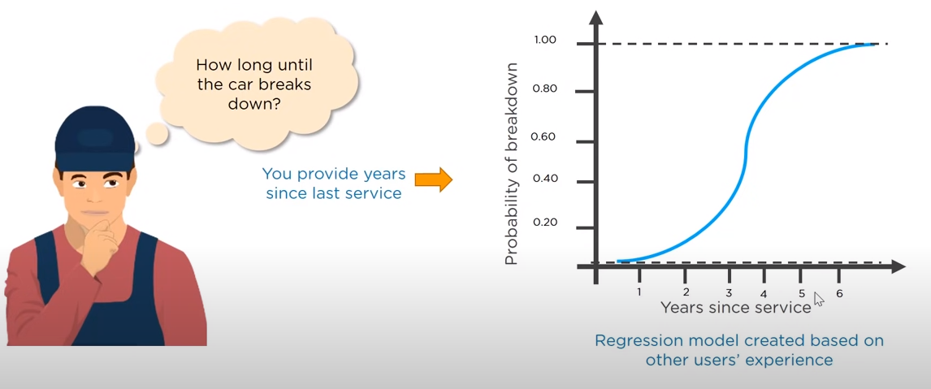
What is Logistic Regression ?

Slide 6
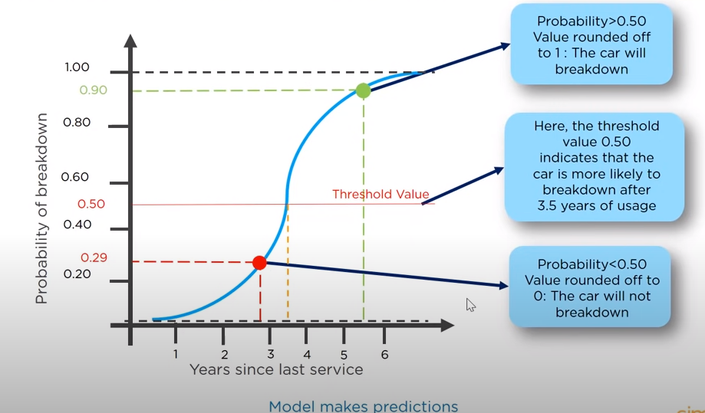
What is Logistic Regression ?

Slide 7
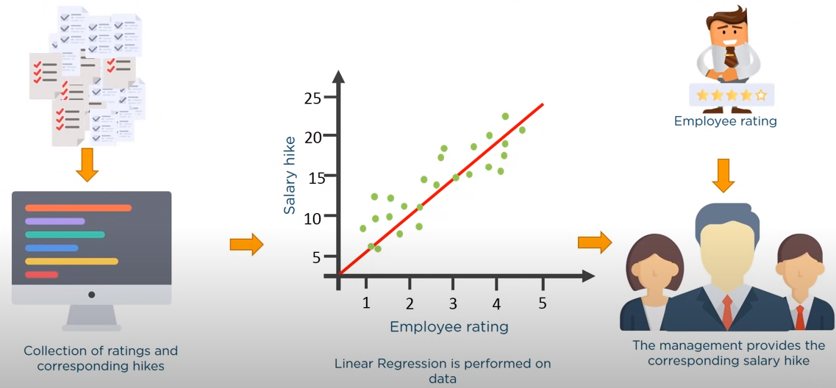
What is Logistic Regression ?

Slide 8
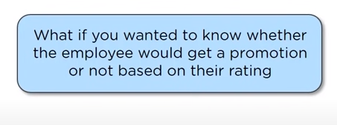
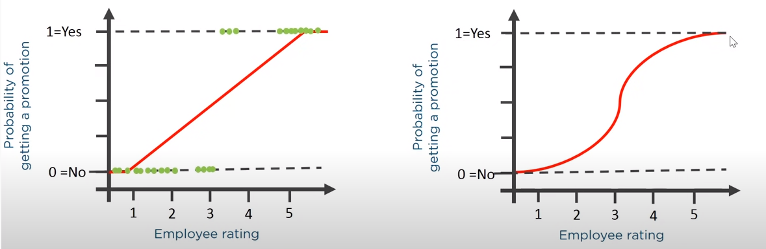
What is Logistic Regression ?

Slide 9
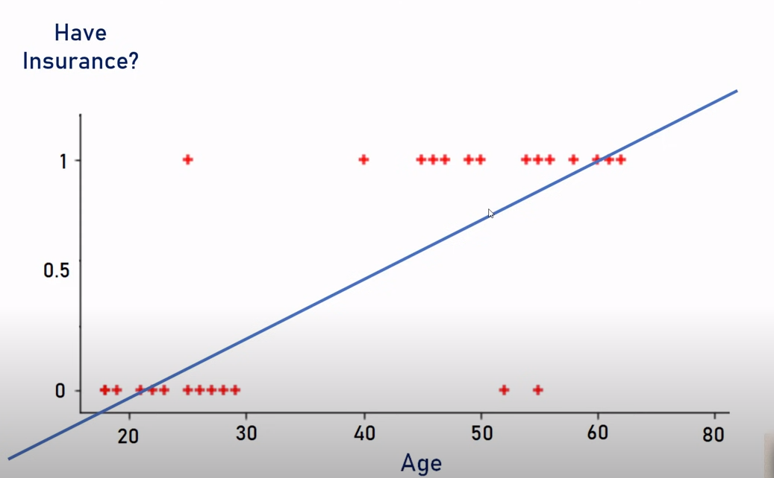
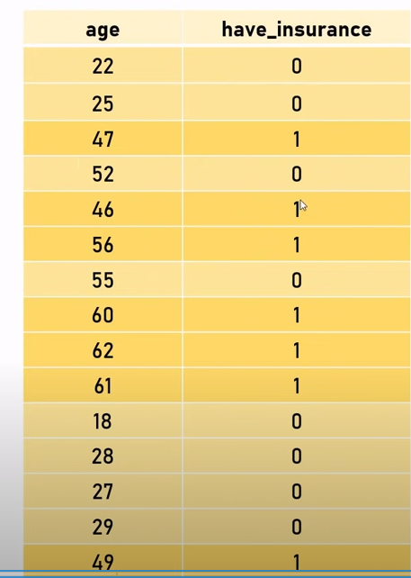
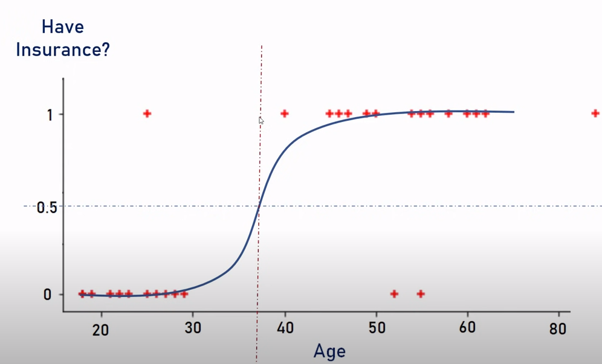
What is Logistic Regression ?

Slide 10
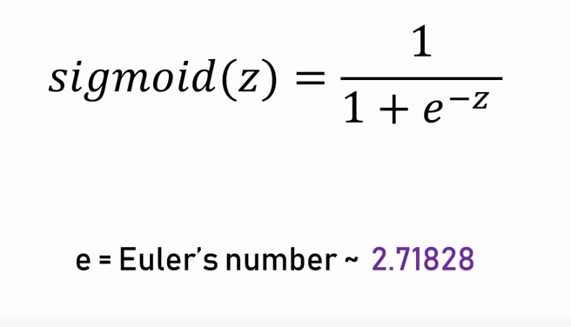
Logistic Function

Slide 11
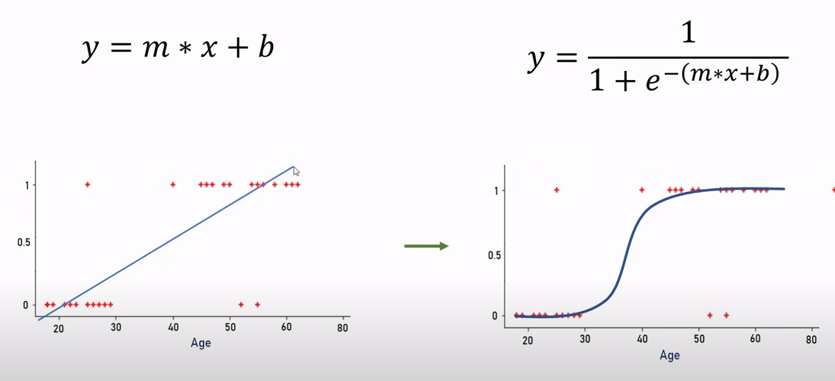
Logistic Function

Slide 12
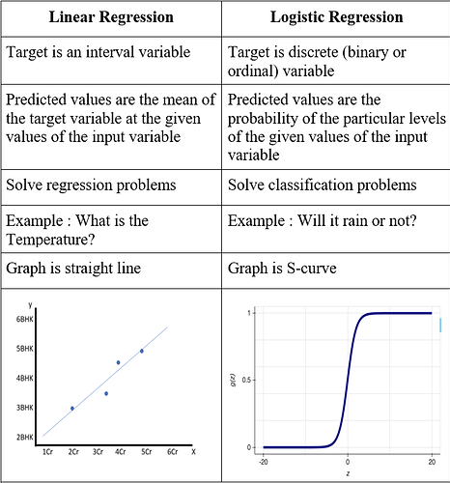
Linear Vs. Logistic Regression

Slide 13

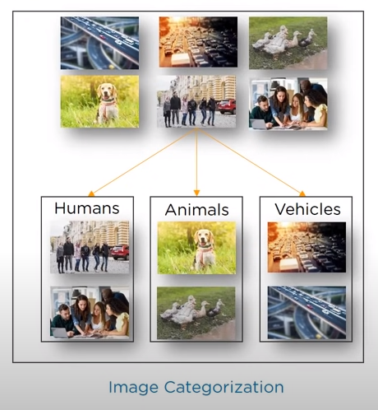
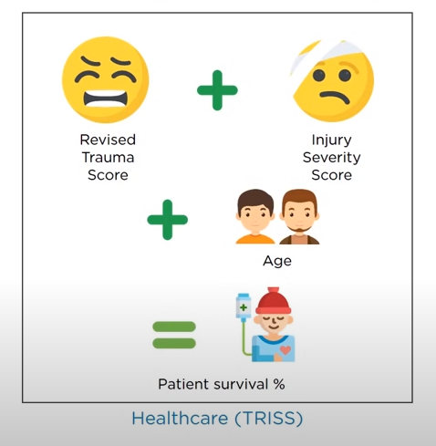
Examples of Logistic Regression

Slide 14
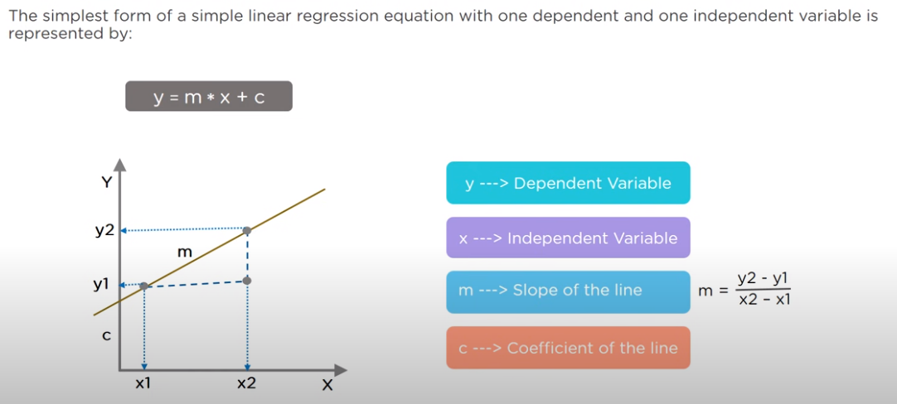
Regression Equation

Slide 15
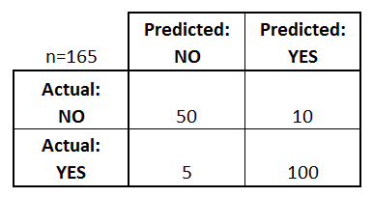
Model Performance – Confusion Matrix
A confusion matrix is a table that is often used to describe the performance of a classification model (or "classifier") on a set of test data for which the true values are known.
There are two possible predicted classes: "yes" and "no".
The classifier made a total of 165 predictions (e.g., 165 patients were being tested for the presence of that disease).
Out of those 165 cases, the classifier predicted "yes" 110 times, and "no" 55 times.
In reality, 105 patients in the sample have the disease, and 60 patients do not.

Slide 16
Model Performance – Confusion Matrix
True Positive (TP)
The predicted value matches the actual value
The actual value was positive and the model predicted a positive value
True Negative (TN)
The predicted value matches the actual value
The actual value was negative and the model predicted a negative value
False Positive (FP) – Type 1 error
The predicted value was falsely predicted
The actual value was negative but the model predicted a positive value
Also known as the Type 1 error
False Negative (FN) – Type 2 error
The predicted value was falsely predicted
The actual value was positive but the model predicted a negative value
Also known as the Type 2 error

Slide 17
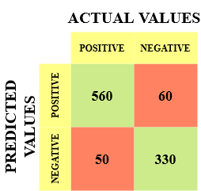
Model Performance – Confusion Matrix
True Positive (TP) = 560; meaning 560 positive class data points were correctly classified by the model
True Negative (TN) = 330; meaning 330 negative class data points were correctly classified by the model
False Positive (FP) = 60; meaning 60 negative class data points were incorrectly classified as belonging to the positive class by the model
False Negative (FN) = 50; meaning 50 positive class data points were incorrectly classified as belonging to the negative class by the model

Slide 18
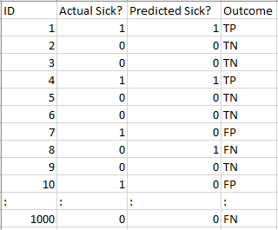

Why Need Confusion Matrix ?
TP = 30, TN = 930, FP = 30, FN = 10
96%! Not bad!
But it is giving the wrong idea about the result.
Our model is saying “I can predict sick people 96% of the time”. However, it is doing the opposite.
It is predicting the people who will not get sick with 96% accuracy while the sick are spreading the virus!

Slide 19


Precision Vs. Recall
Precision tells us how many of the correctly predicted cases actually turned out to be positive.
Recall tells us how many of the actual positive cases we were able to predict correctly with our model.

Slide 20
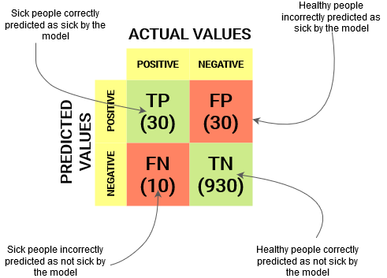
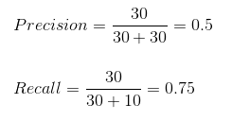
Precision Vs. Recall
50% percent of the correctly predicted cases turned out to be positive cases. Whereas 75% of the positives were successfully predicted by our model. Awesome!
Precision is a useful metric in cases where False Positive is a higher concern than False Negatives.
Precision is important in music or video recommendation systems, e-commerce websites, etc. Wrong results could lead to customer churn and be harmful to the business.
Recall is a useful metric in cases where False Negative trumps False Positive.
Recall is important in medical cases where it doesn’t matter whether we raise a false alarm but the actual positive cases should not go undetected!

Slide 21

Model Performance – F1 Score
In practice, when we try to increase the precision of our model, the recall goes down, and vice-versa. The F1-score captures both the trends in a single value:
F1-score is a harmonic mean of Precision and Recall, and so it gives a combined idea about these two metrics. It is maximum when Precision is equal to Recall.

Slide 22


Python Matrix
Sklearn has two great functions: confusion_matrix() and classification_report().
Sklearn confusion_matrix() returns the values of the Confusion matrix.
It takes the rows as Actual values and the columns as Predicted values. The rest of the concept remains the same.
Sklearn classification_report() outputs precision, recall and f1-score for each target class. In addition to this, it also has some extra values: micro avg, macro avg, and weighted avg

Slide 23
THANK YOU !!!
Amol Patil - 9822291613

